Slide 1



Thesis Supervision Committee
Design of an Integrated Modular Motor Drive (IMMD) for Traction Applications
Mesut Uğur
Department of Electrical and Electronics Engineering
Middle East Technical University
26.12.2018
Supervisor: Asst. Prof. Dr. Ozan Keysan

Slide 2
Outline
Thesis Topic
Research Opportunities
Master Plan
Research Work
Prototype Implementation
Test Results
Future plan

Slide 3
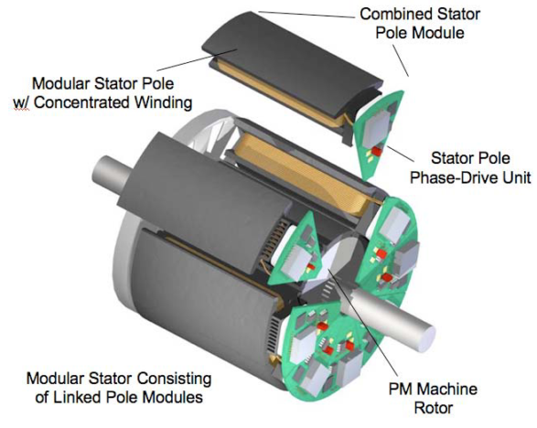
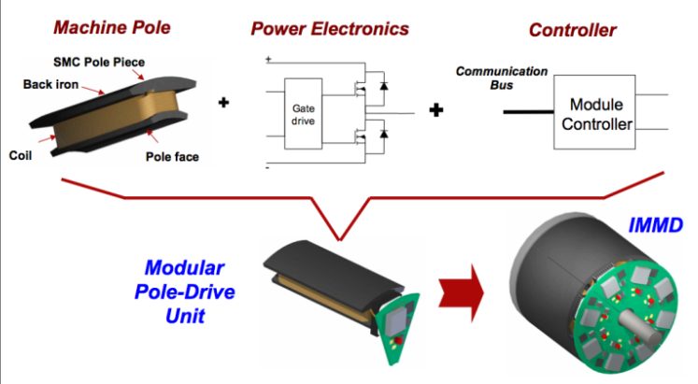
Thesis Topic
Integrated Modular Motor Drive
The motor drive is integrated to the motor
Both the motor and the drive are modularized
Increased power density
Reduced cost
Reduced EMI
Fault tolerance
Redundancy
Reduced stress
Applications
Mission or safety critical applications
Size, volume or weight constraints
Challenges
Size reduction
Thermal management
Vibration
Brown, N. R., Jahns, T. M., & Lorenz, R. D. (2007). Power Converter Design for an Integrated Modular Motor Drive. Industry Applications Conference, 2007. 42nd IAS Annual Meeting. Conference Record of the 2007 IEEE, 1322–1328.
Shea, A., & Jahns, T. M. (2014). Hardware integration for an integrated modular motor drive including distributed control. In 2014 IEEE Energy Conversion Congress and Exposition (ECCE) (pp. 4881–4887). IEEE.

Slide 4
Research Opportunities
Wide Band-Gap Power Semiconductor Devices: GaN FETs
Layout design, parasitics modeling and minimization
Size reduction, passive component design and optimization
Modular motor drive topologies, fault tolerance, interleaving
Fault tolerant operation of machines, fault detection and re-action
Permanent magnet motor design and optimization
Vibration effects and minimization
Thermal management of two heat sources in close proximity
Filter design with planar magnetics

Slide 5
Master Plan
Two IMMD prototypes
A proof of concept prototype with:
Utilization of GaN FETs at 8 kW
Modular design with 2-series and 2-parallel connected inverters
Permanent magnet synchronous machine
Different windings configurations (fractional slot concentrated winding)
Fault detection, analysis and operation under fault
Going through all the design, manufacturing, assembling and testing procedures
An IMMD prototype for an aerospace or traction application
Aircraft fuel pump
In-wheel motor
etc.

Slide 6

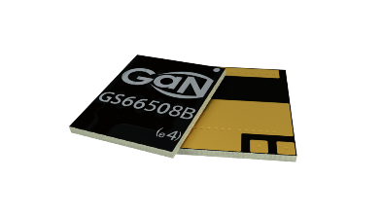
Research Work
Design of the 8 kW IMMD system: Drive parameters
Parameter | Value
Motor output power, P_{out} | 8 kW
DC link voltage, V_{dc} | 540 V
Number of phases, m | 3
Power factor, pf | 0.9
Motor speed, N_{r} | 600 rpm
Parameter | Value | Parameter | Value
Type | E-mode GaN | Manufacturer | GaN Systems
Voltage | 650 V | Current (25 ⁰C) | 30 A
R_{ds,on} (25 ⁰C) | 50 mΩ | R_{ds,on} (150 ⁰C) | 129 mΩ
Rise time | 4.9 ns | Fall time | 3.4 ns
Turn-on energy | 47.5 µJ | Turn-off energy | 7.5 µJ

Slide 7
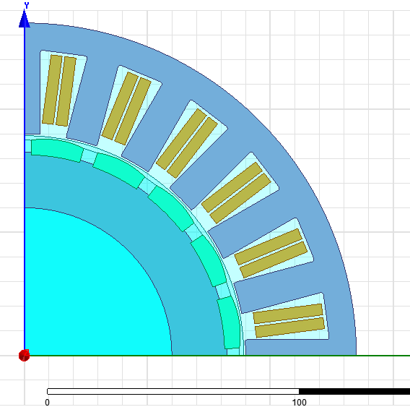
Research Work
Design of the 8 kW IMMD system: Motor parameters
Parameter | Value | Parameter | Value
Stator slot number, Q_{s} | 24 | Air gap length, l_{g} | 1.5 mm
Rotor pole number, p | 20 | Magnet height, l_{m} | 4.5 mm
Motor axial length, L_{a} | 135 mm | Number of turns per coil, z_{Q} | 40
Stator outer diameter, D_{os} | 270 mm | Slot fill factor, k_{cu} | 0.4
Stator inner diameter, D_{is} | 180 mm | Stator winding factor, k_{w} | 0.933

Slide 8
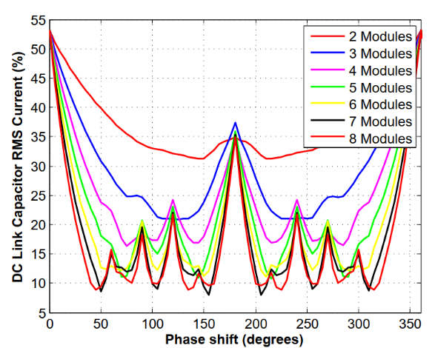
Research Work
Design of the 8 kW IMMD system: Capacitor & interleaving
Parametre | Value
Capacitor current (RMS), I_{c,rms} | 5.76 A
Capacitance, C_{dc} | 18 µF
Capacitor voltage, V_{c} | 300 V
Total number of capacitors | 2

Slide 9
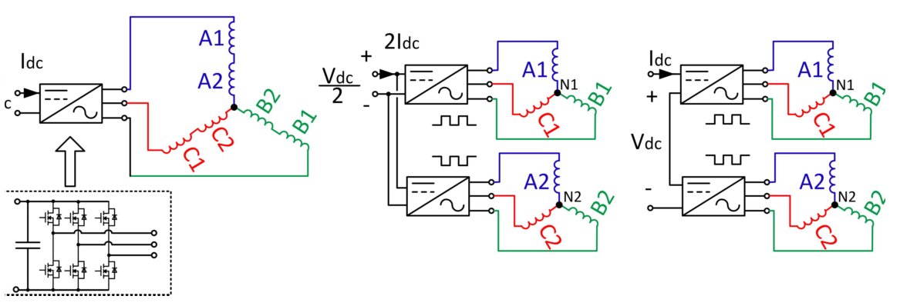
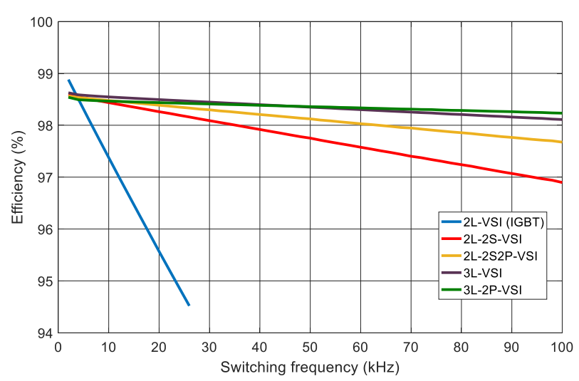
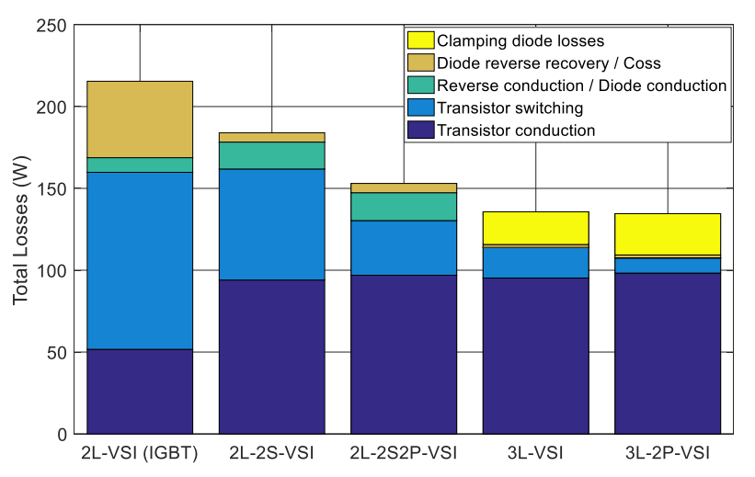
Research Work
Topology Evaluation
Conventional
Parallel
Series
Efficiency vs Switching frequency
Power loss components

Slide 10
Research Work
GaN Modeling: Steady-state and transient models
Capacitance model
Forward characteristics
Reverse characteristics
Temperature effect

Slide 11
Research Work
GaN Modeling: Switching characteristics
Top
turn-on
Top
turn-off
Bottom
turn-off
Bottom
turn-on

Slide 12
Research Work
GaN Modeling: Parameter effects
Temperature effect
Load current
R_{G-on} effect
R_{G-off} effect

Slide 13
Research Work
Motor design: Design procedure and numerical results
Parameter | Value
Induced voltage per phase per module, E_{ph-m} | 78 V_{rms}
Line current per phase per module, I_{ph-m} | 10 A_{rms}
Motor torque, T_{m} | 127 Nm
Fill factor, k_{cu} | 38 %
Current density, J_{rms} | 3.8 A/mm²
Copper loss, P_{cu} | 229 W
Core loss, P_{core} | 96 W
Motor efficiency, η_{m} | 95.9 %
Torque ripple: 0.63 %
Cogging torque: 0.29 %
Inductance: 3.66 mH
This will result in relatively high short circuit current
Electromagnetic model
Slot geometry
Magnet shape

Slide 14
Research Work
Motor design: FEA results
Motor torque
Induced voltages

Slide 15
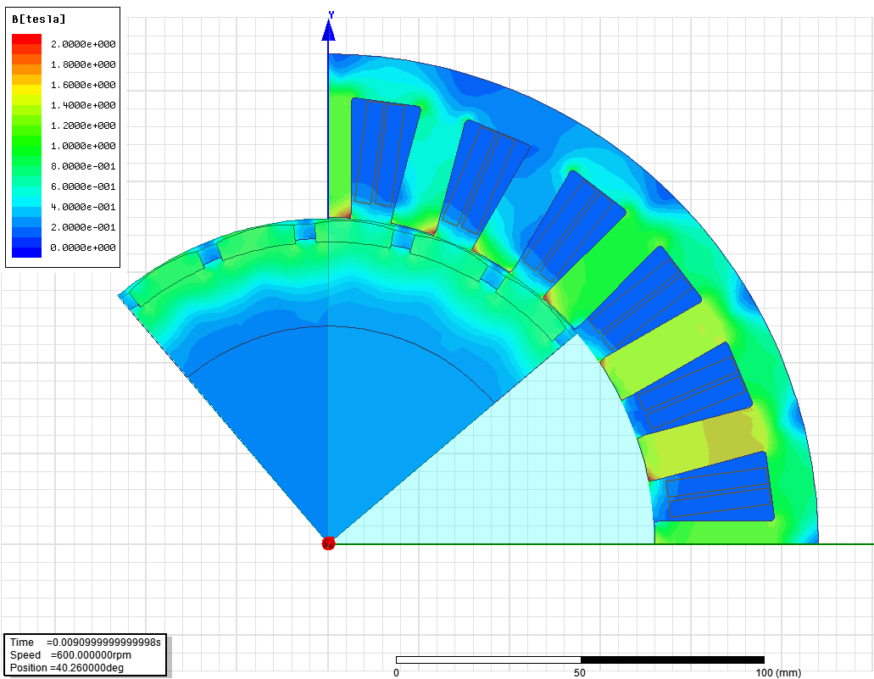
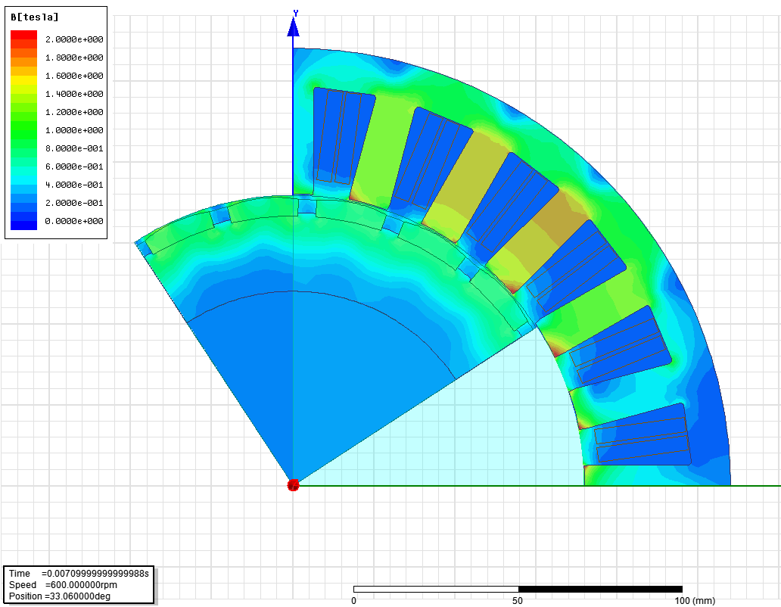
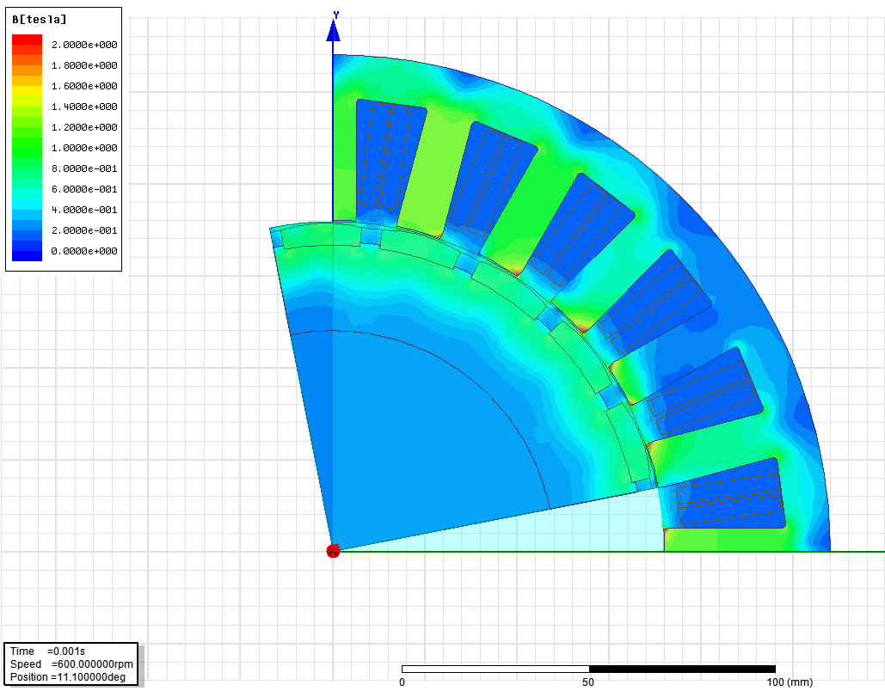
Research Work
Motor design: FEA results
Line currents
Flux density distribution

Slide 16
Prototype Implementation
IMMD system design: Architecture

Slide 17
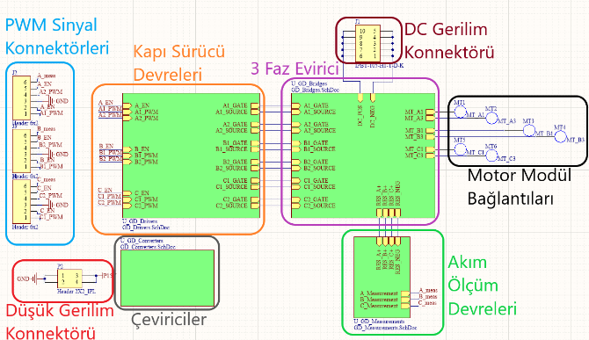
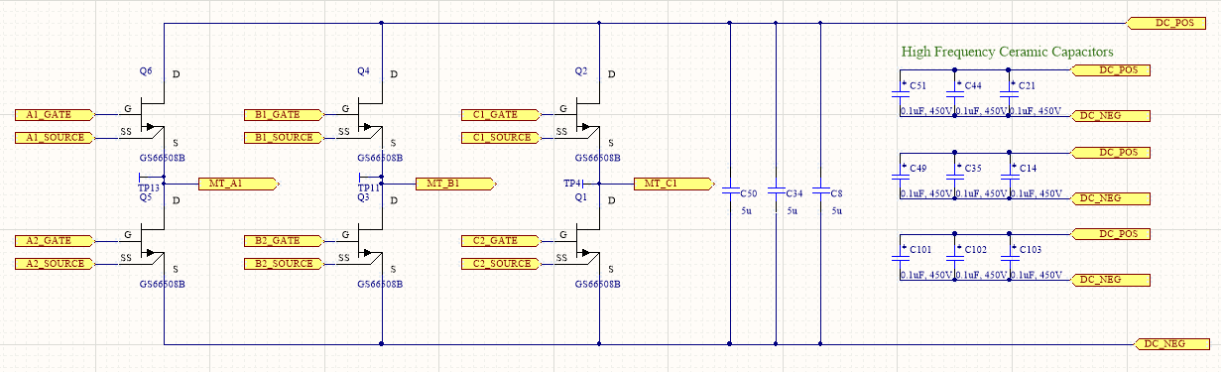
Prototype Implementation
Motor drive inverter PCB design

Slide 18
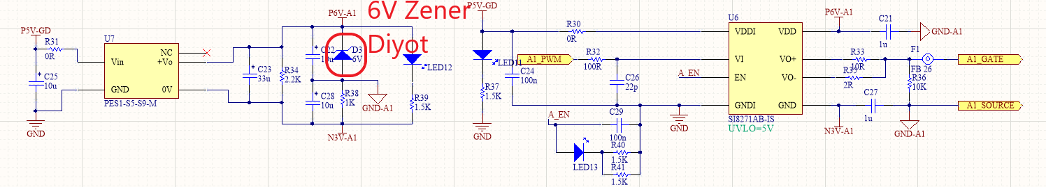
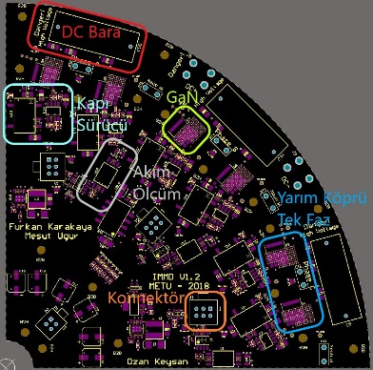
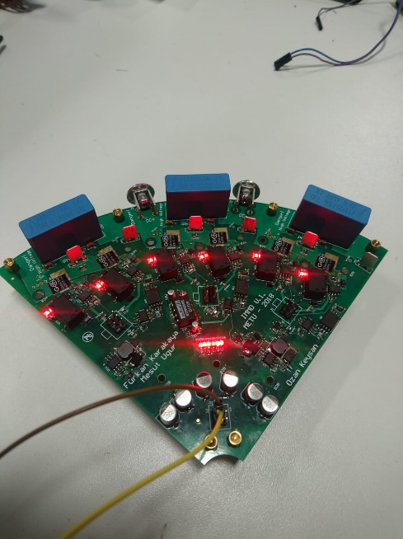
Prototype Implementation
Motor drive inverter PCB design

Slide 19
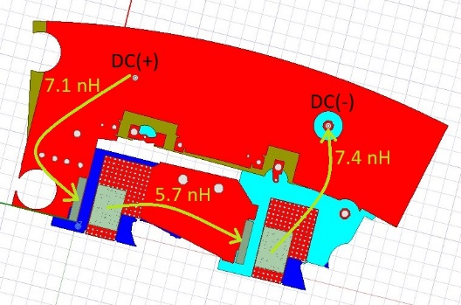
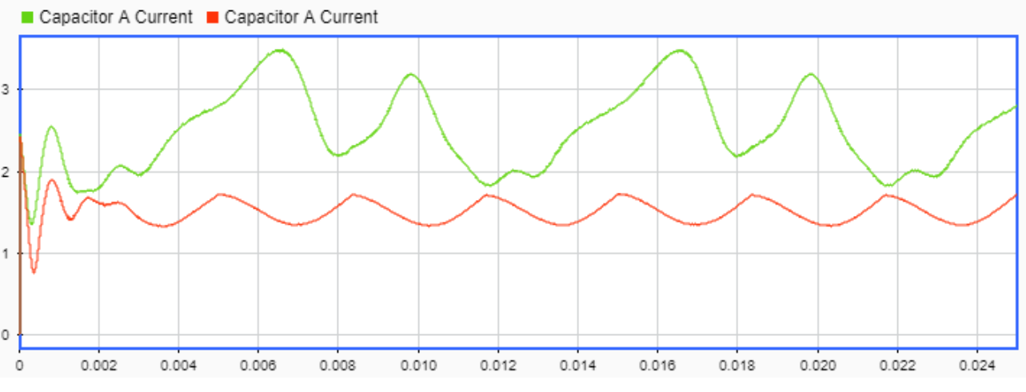
Prototype Implementation
Parasitic modeling: Inductance and resistance
ANSYS/Q3D Extractor
Inductance map of the PCB
Effect of inductances on capacitor RMS current

Slide 20
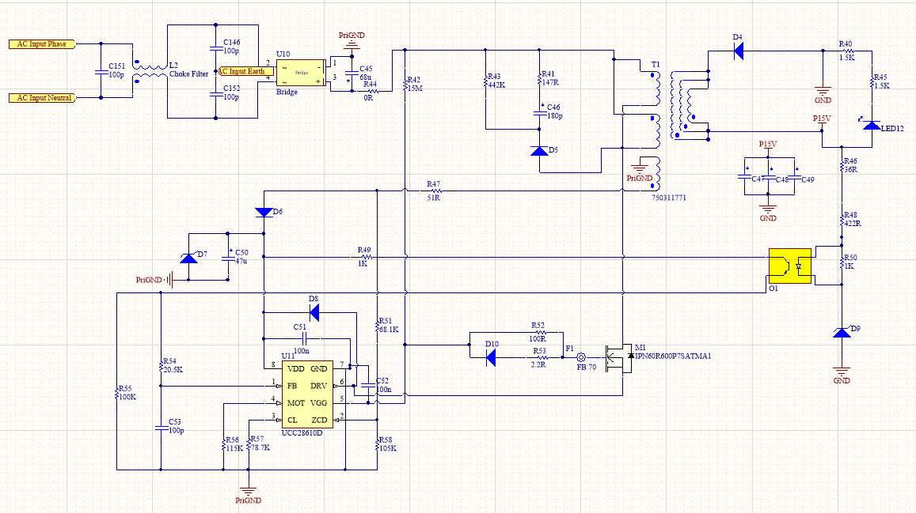
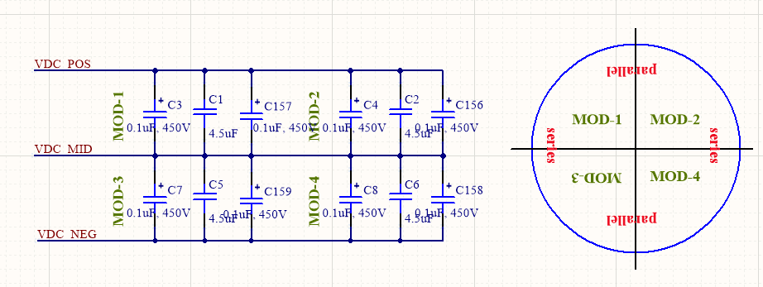
Prototype Implementation
Control PCB design: Schematic
Power supply (Flyback converter)
Interchangable DC link connections
Micro-controller (DSP) circuit
JTAG interface
Communication interface
DC link voltage measurement
ADC filters, PWM circuits etc.
DC Link distribution

Slide 21
Prototype Implementation
Control PCB design: Layout

Slide 22
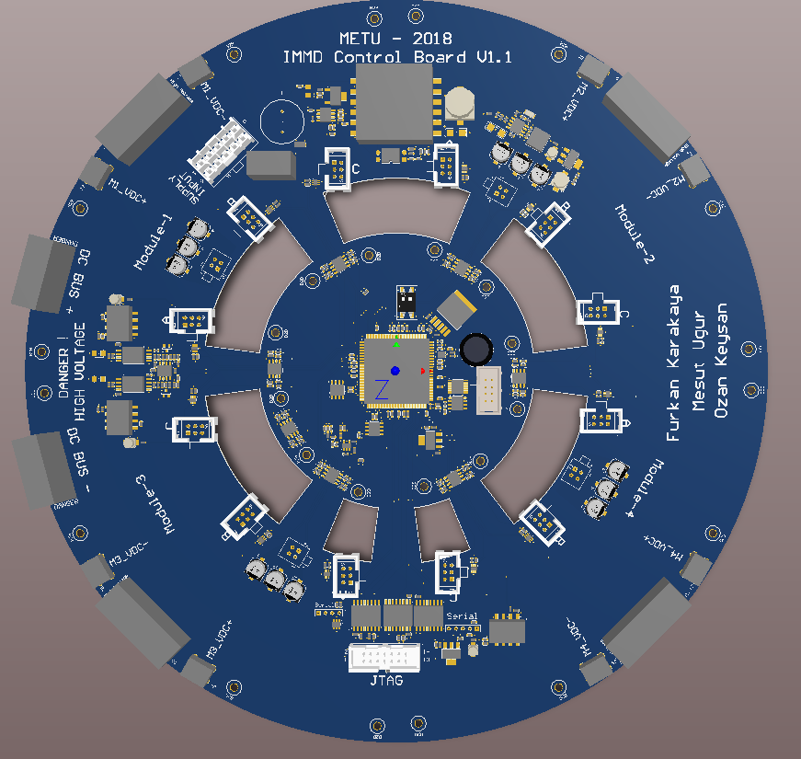
Prototype Implementation
Control PCB design: 3D view

Slide 23
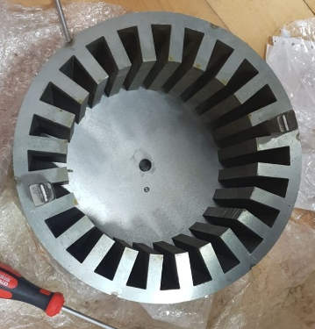
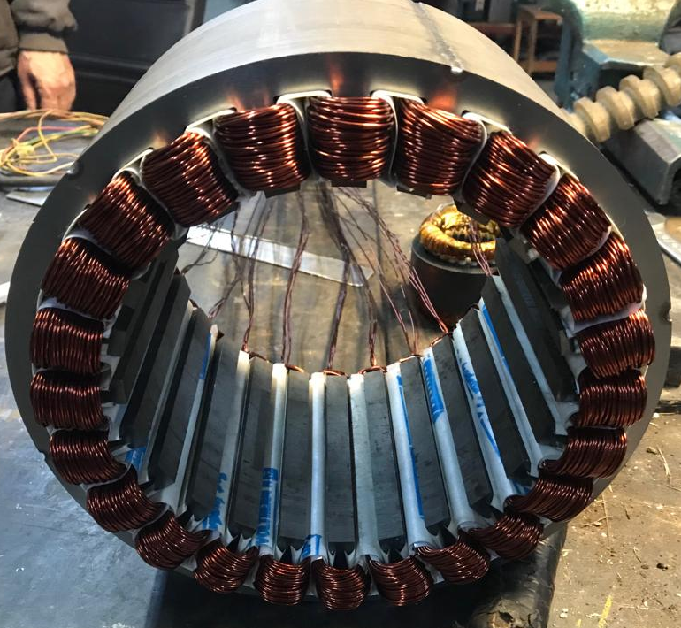
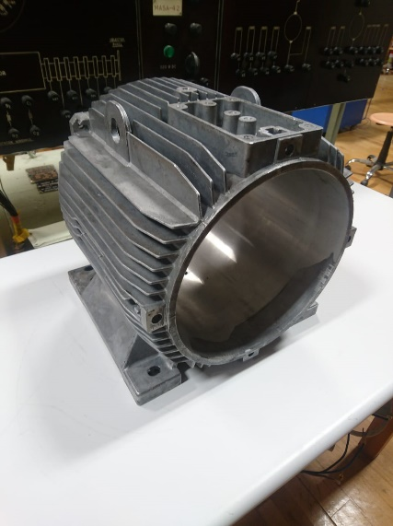
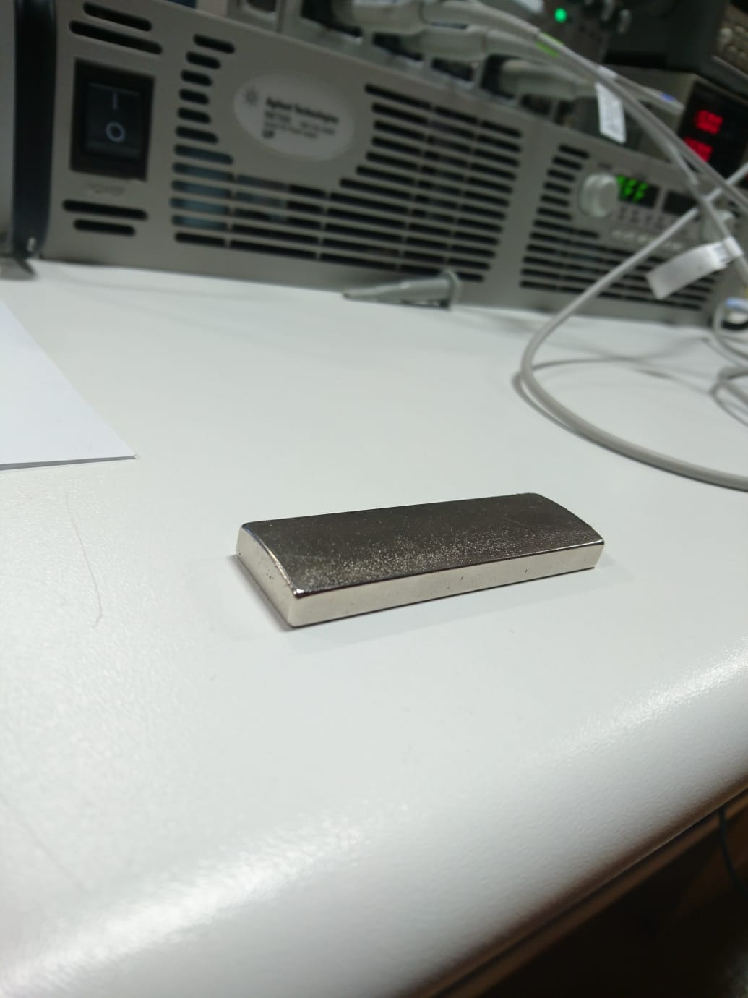
Prototype Implementation
Motor manufacturing

Slide 24
Prototype Implementation
Thermal design: Lumped parameter network
Parameter | Value | Parameter | Value
Ambient temperature | 40 ⁰C | PCB thermal resistance | 3.39 ⁰C/W
Junction temperature | 140 ⁰C | TIM thermal resistance | 0.13 ⁰C/W
Power loss | 7 W | Junction-to-case thermal resistance | 0.5 ⁰C/W

Slide 25
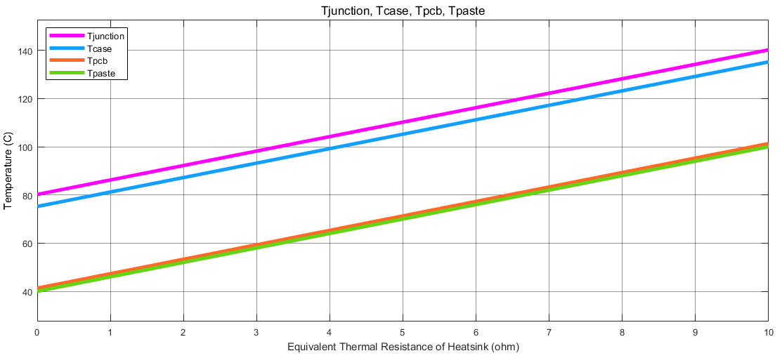
Prototype Implementation
Thermal design: Analysis
Lumped parameter thermal network simulation:
Operating point
Required R_{th_hs} = 1 ⁰C/W
Analytical calculation of convection coefficient (natural & forced)
h = 5.1 W/m-K for natural convection
h = 18.4 W/m-K for forced convection (1 m/s air flow)

Slide 26
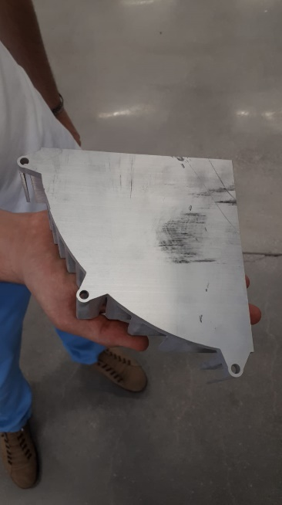
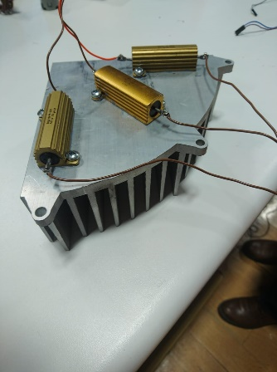
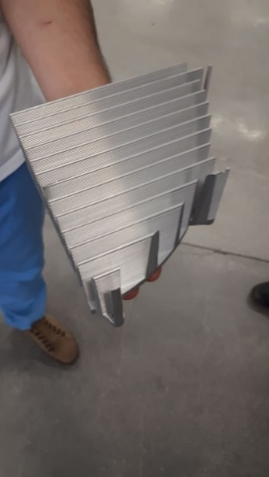
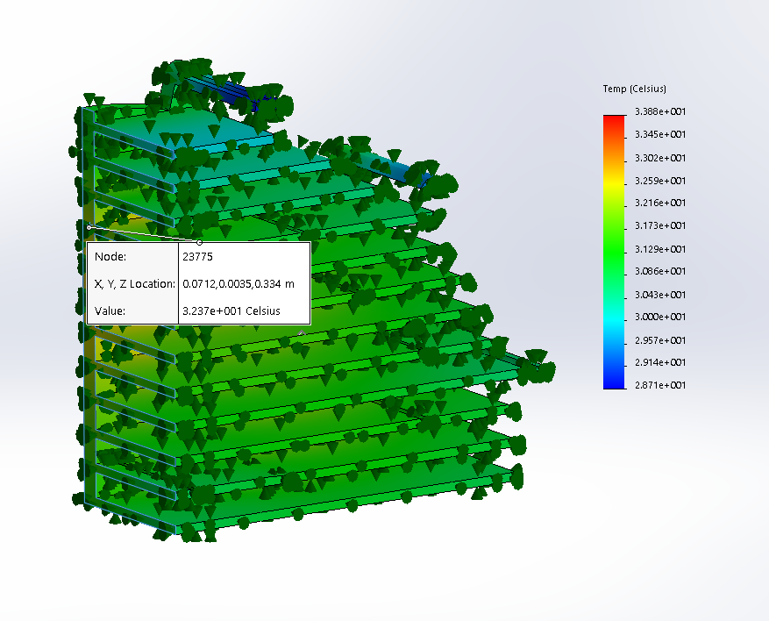
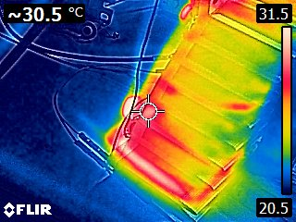
Prototype Implementation
Thermal design: Heat sink & thermal tests

Slide 27
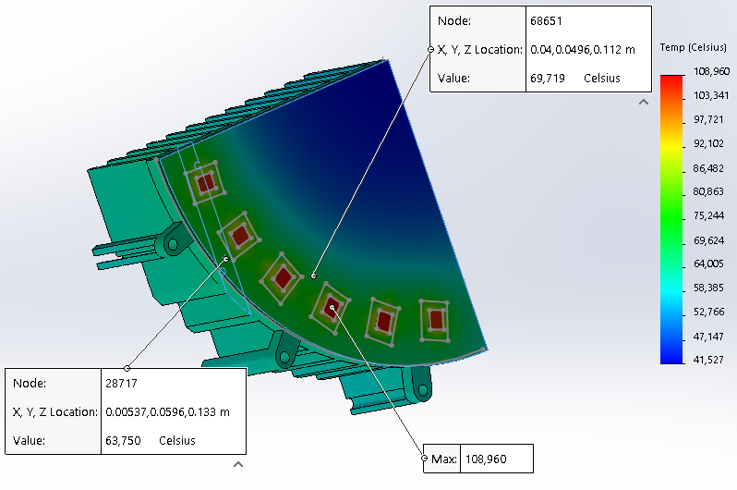
Prototype Implementation
Thermal design: Finite element Analysis
Loss: 10W per GaN
Ambient: 40 ⁰C
Convection coefficienct: 18 𝑊/(𝑚−𝐾)
Junction: 109 ⁰C

Slide 28
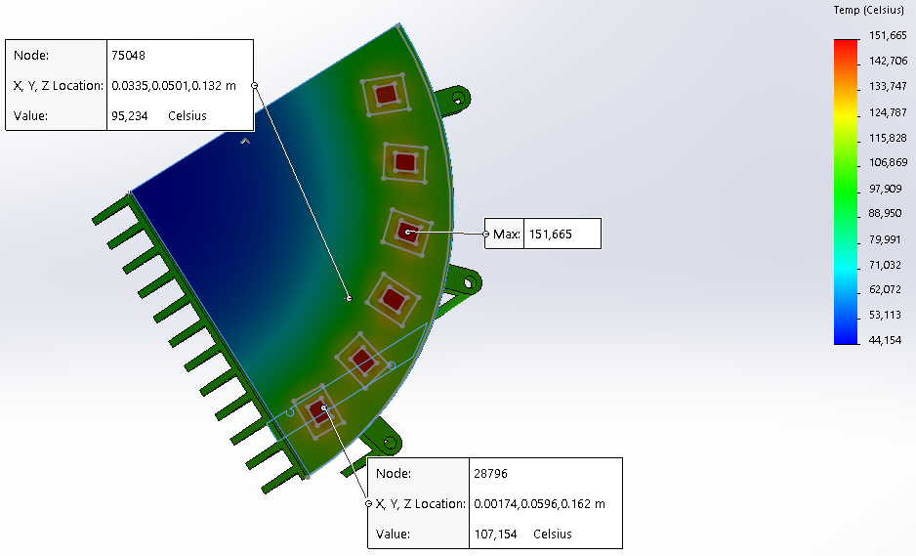
Prototype Implementation
Thermal design: Finite element Analysis
Loss: 10W per GaN
Ambient: 40 ⁰C
Convection coefficienct: 5 𝑊/(𝑚−𝐾)
Junction: 151 ⁰C

Slide 29
Prototype Implementation
Mechanical design: Overall system

Slide 30
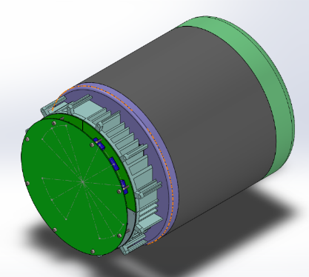
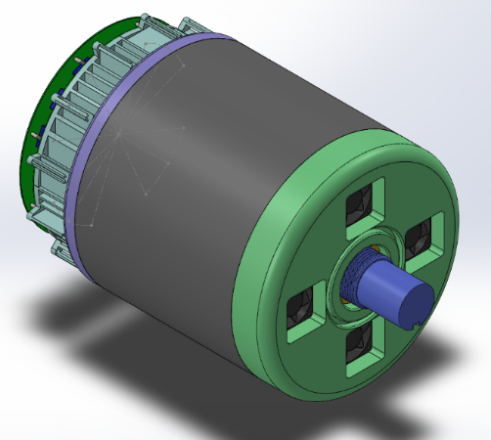
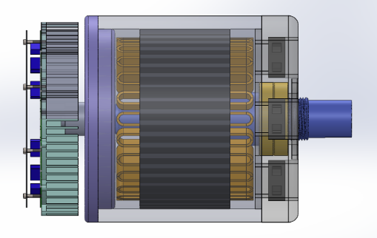
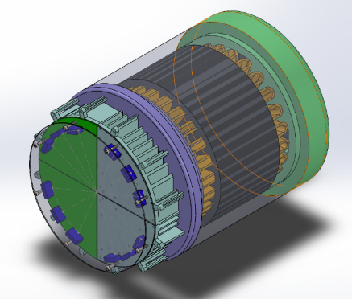
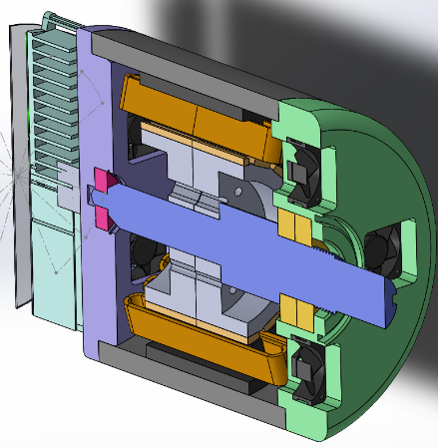
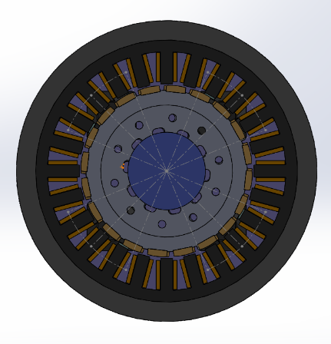
Prototype Implementation
Mechanical design

Slide 31
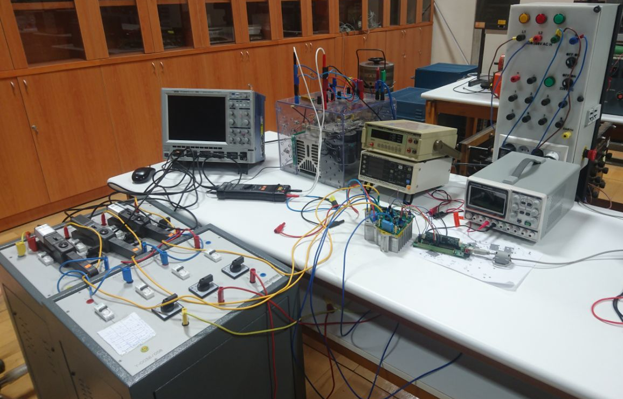
Experimental Results
Motor Drive Tests: Experimental setup
500 MHz oscilloscope
Rectifier & DC Bus
DC & AC wattmeters
Probes
Power supply
Resistive & inductive loads
Inverter module
DSP board

Slide 32
Experimental Results
Motor Drive Tests: Test plan
PCB functional tests ✔
Gate driver tests ✔
Test 0: Double pulse test (DPT) @ 100V, 10A ✔
Test 1: No load, Vdc = 100 V, fsw = 40 kHz ✔
Test 2: 60 W , Vdc = 100 V, fsw = 10 kHz ✔
Test 3: 300 W , Vdc = 100 V, fsw = 10 kHz ✔
Test 3.5: Double pulse test (DPT) applied to each phase @ 270V, 20A
Test 4: 410 W , Vdc = 270 V, fsw = 10 kHz
Test 5: 2000 W, Vdc = 270 V, fsw = 10 kHz
Test 6: 2000 W, Vdc = 270 V, fsw = 40 kHz

Slide 33
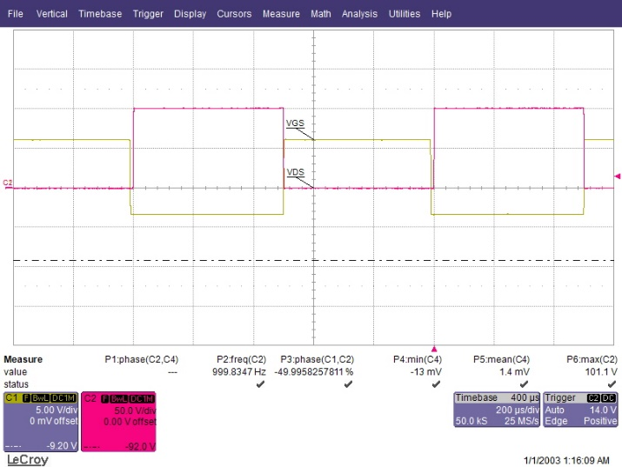
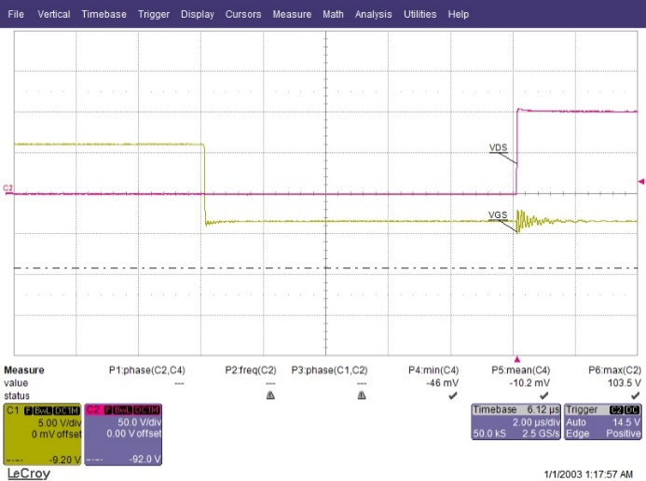
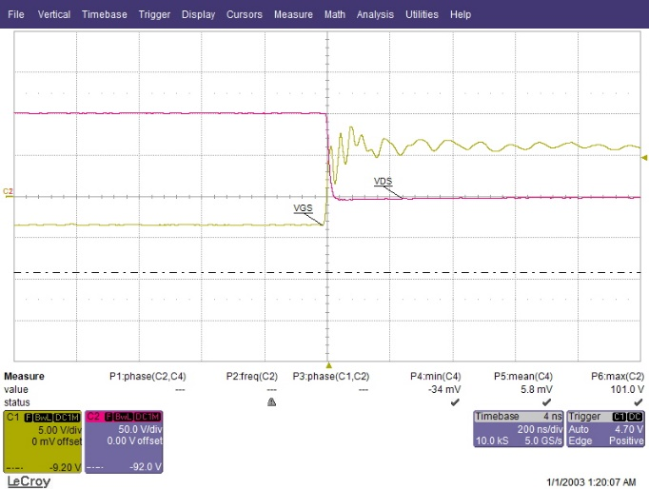
Experimental Results
Motor Drive Tests: Results
Double pulse test
Square wave operation
3-phase sinusoidal PWM
Configurable magnitude, frequency, dead-band etc.
Turn-off
Turn-on
Gate-source waveforms

Slide 34
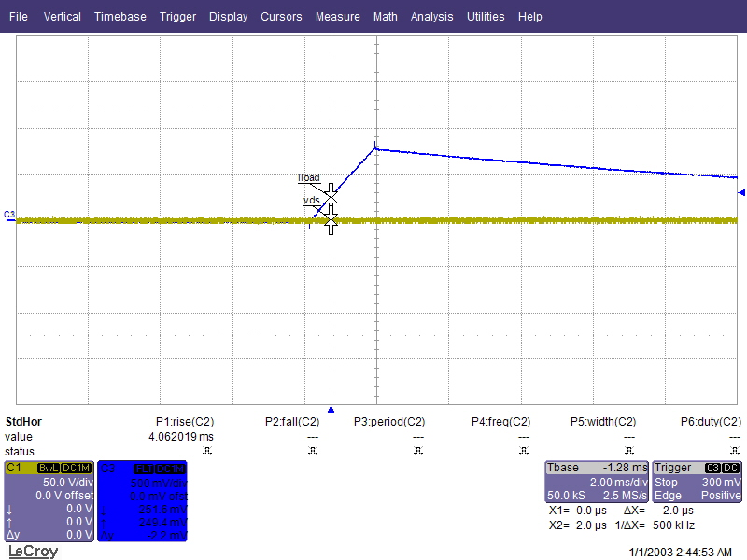
Experimental Results
Motor Drive Tests: Double pulse test
Load current
During DPT, one GaN FET is lost (gate driver zener diode is destroyed)

Slide 35
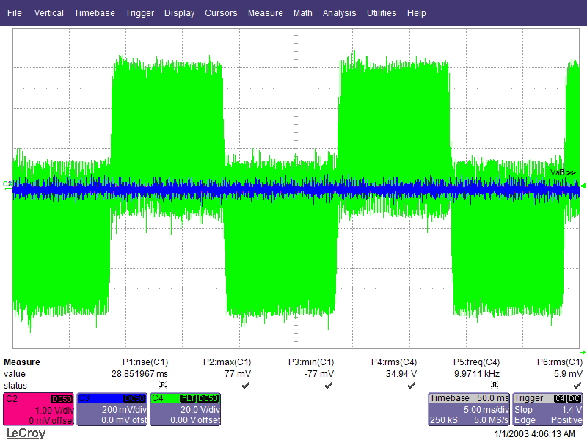
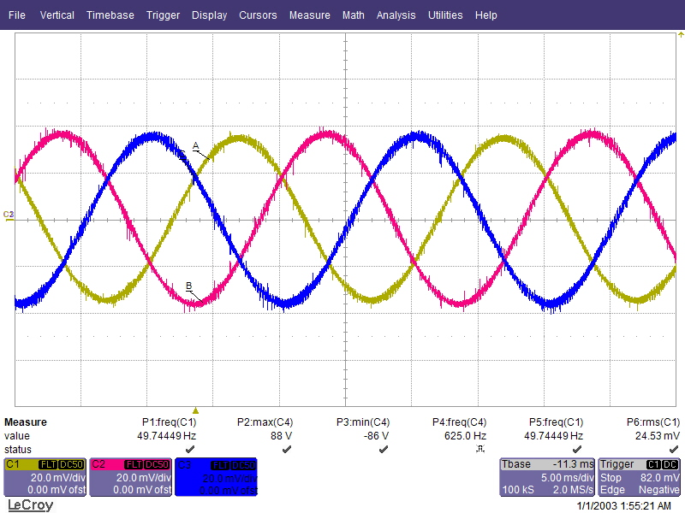
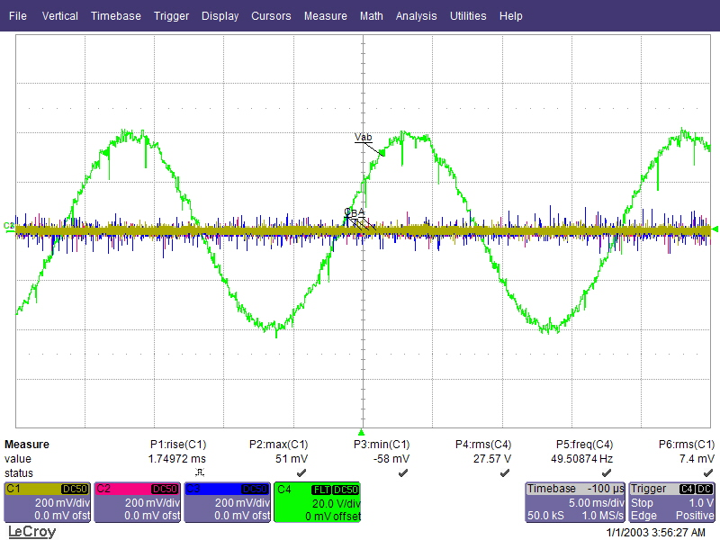
Experimental Results
Motor Drive Tests: Test-3 Results
Line-to-line voltage
Line currents

Slide 36
Experimental Results
Motor Drive Tests: Test-3 Results
During low voltage (100V) test, one GaN is lost due to experimental setup grounding

Slide 37
Experimental Results
Motor Drive Tests: Test-4
During high voltage (270V) test, four GaNs are destroyed at 225V:
1. Voltage clearance: Clearance test is performed up to 560V between all possible nodes. PCB passed this test.
2. Voltage breakdown due to overshoot: Still under investigation. Tests are applied in DPT mode up to 300V and results suggest that there is no overshoot problem.

Slide 38
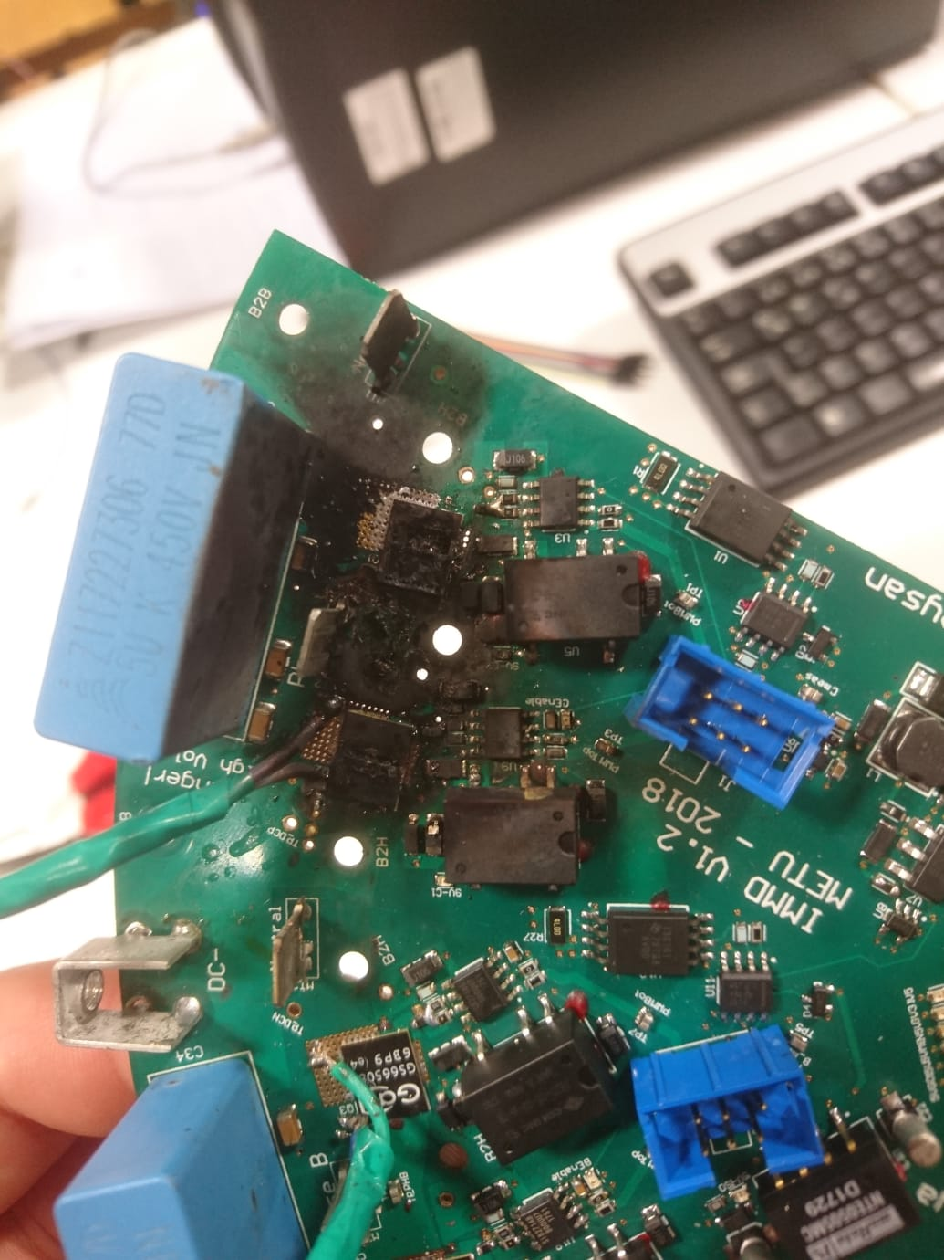
Experimental Results
Motor Drive Tests: Results of DPT applied to each phase
Phase-A
Phase-C
Phase-B
All-phases

Slide 39
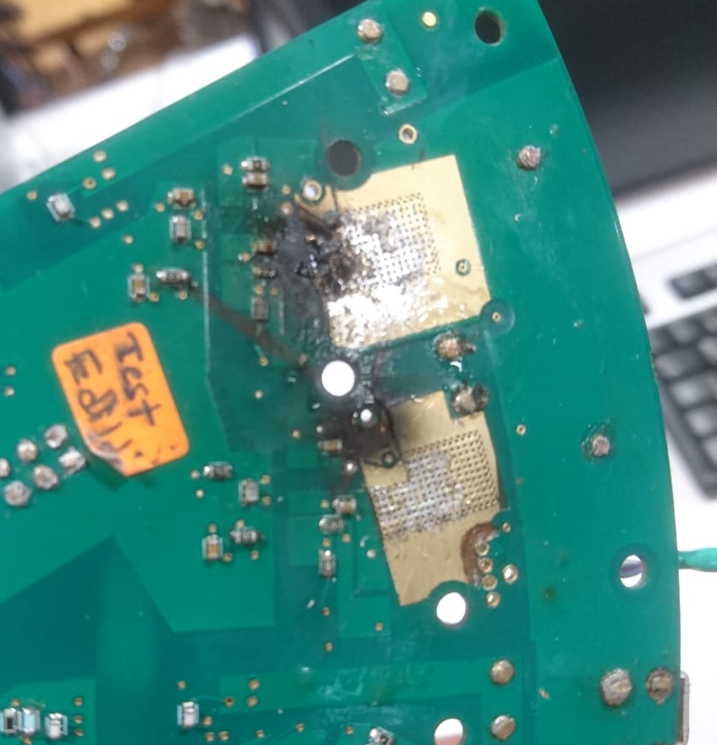
Experimental Results
Motor Drive Tests: Results of DPT applied to each phase

Slide 40
Future plan
What is ahead: Short term
Continue with inverter tests, figure out and solve the problem
Assemble 3 more motor drive module PCBs and test them
Assemble control board and test it
Test the motor drive module on a motor
Assemble the control PCB and motor drive modules altogether
Manufacture the remaining motor and mechanical parts
Assemble the motor
Test the motor parameters
Drive the motor with a commercial drive to see its performance
Assemble the IMMD altogether (drive + motor)
Test the IMMD system
Fault tolerance tests

Slide 41
Future plan
What is ahead: Long term

Slide 42
Publications
DC Link Capacitor Optimization for Integrated Modular Motor Drives
IEEE 26th International Symposium on Industrial Electronics (ISIE 2017)
Tümleşik Modüler Motor Sürücü Sistemi Tasarımı
1. Ulusal Enerji Dönüşümü Kongresi (EL-EN 2017)-Fırat Üniversitesi Mühendislik Bilimleri Dergisi
Multi-physics design optimization of a GaN based integrated modular motor drive system
The 9th International Conference on Power Electronics, Machines and Drives (PEMD 2018)
Investigation of Turn-on and Turn-off Characteristics of Enhancement-Mode GaN Power Transistors
20th European Conference on Power Electronics and Applications (Energy Conversion Conference and Exhibition) (EPE 2018)
Comparison of Inverter Topologies Suited for Integrated Modular Motor Drive Applications
18th International Conference on Power Electronics and Motion Control (PEMC 2018)
Design of a GaN Based Integrated Modular Motor Drive
The International Conference on Electrical Machines (ICEM 2018)

Slide 43
References
Brown, N. R., Jahns, T. M., & Lorenz, R. D. (2007). Power Converter Design for an Integrated Modular Motor Drive. Industry Applications Conference, 2007. 42nd IAS Annual Meeting. Conference Record of the 2007 IEEE, 1322–1328.
Shea, A., & Jahns, T. M. (2014). Hardware integration for an integrated modular motor drive including distributed control. In 2014 IEEE Energy Conversion Congress and Exposition (ECCE) (pp. 4881–4887). IEEE.
Marz, M., Schletz, A., Eckardt, B., Egelkraut, S., & Rauh, H. (2010). Power electronics system integration for electric and hybrid vehicles. Integrated Power Electronics Systems (CIPS), 2010 6th International Conference On, 16–18.
Wheeler, P. W., Clare, J. C., Apap, M., Empringham, L., Bradley, K. J., Pickering, S., & Lampard, D. (2005). A fully integrated 30 kW motor drive using matrix converter technology. Proc. EPE ’05, 9, 9–16.
Wang, J., Li, Y., & Han, Y. (2013). Evaluation and design for an integrated modular motor drive (IMMD) with GaN devices. 2013 IEEE Energy Conversion Congress and Exposition, ECCE 2013, (Immd), 4318–4325
Wang, J., Li, Y., & Han, Y. (2015). Integrated Modular Motor Drive Design With GaN Power FETs. IEEE Transactions on Industry Applications, 51(4), 3198–3207.
Lee, W., Li, S., Han, D., Sarlioglu, B., Minav, T. A., & Pietola, M. (2017). Achieving high-performance electrified actuation system with integrated motor drive and wide bandgap power electronics. In 2017 19th European Conference on Power Electronics and Applications (EPE’17 ECCE Europe) (p. P.1-P.10). IEEE

Slide 44
Acknowledgement
I would like to thank;
My supervisor Ozan Keysan for his encouragement and support,
My colleague Furkan Karakaya for his motivation and hard work in designing GaN based motor drive and testing,
My colleagues Hande Bayazıt and Özgür Yazıcı for their valuable contribution on motor manufacturing and mechanical design,
Members of Research League for their contributions.

Slide 45

Thank you !
Mesut Uğur
mesut.ugur@metu.edu.tr
Department of Electrical and Electronics Engineering
Middle East Technical University
power.eee.metu.edu.tr

